Slide 1
SOLID Principles
Artem Otliaguzov

Slide 2
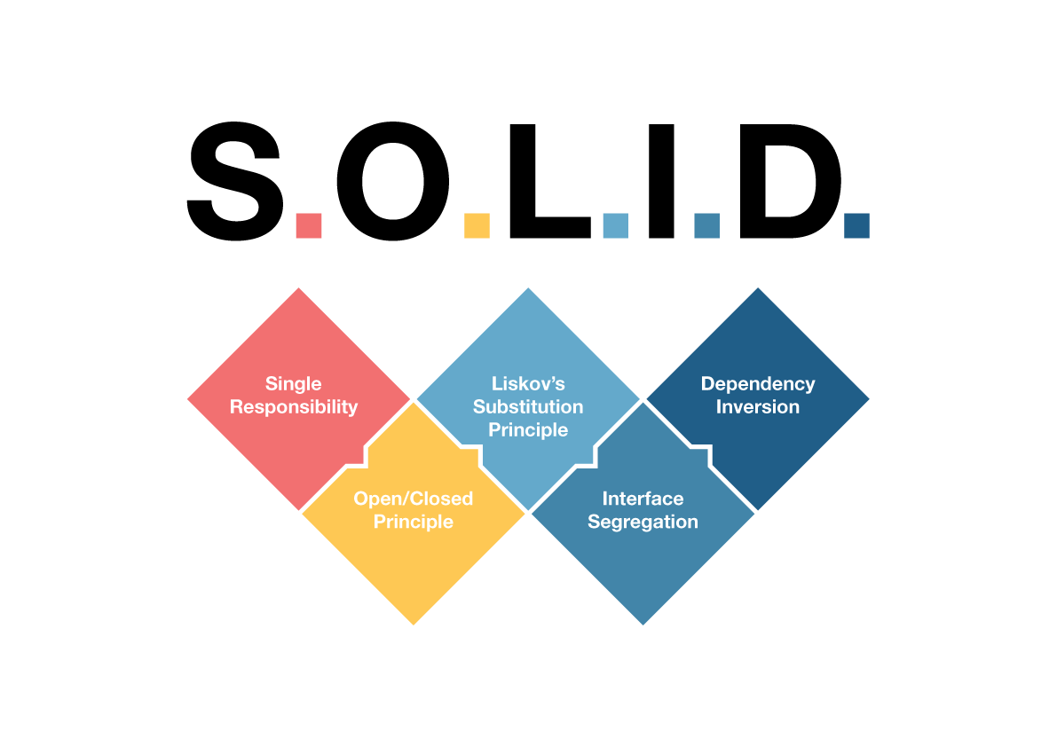

Slide 3
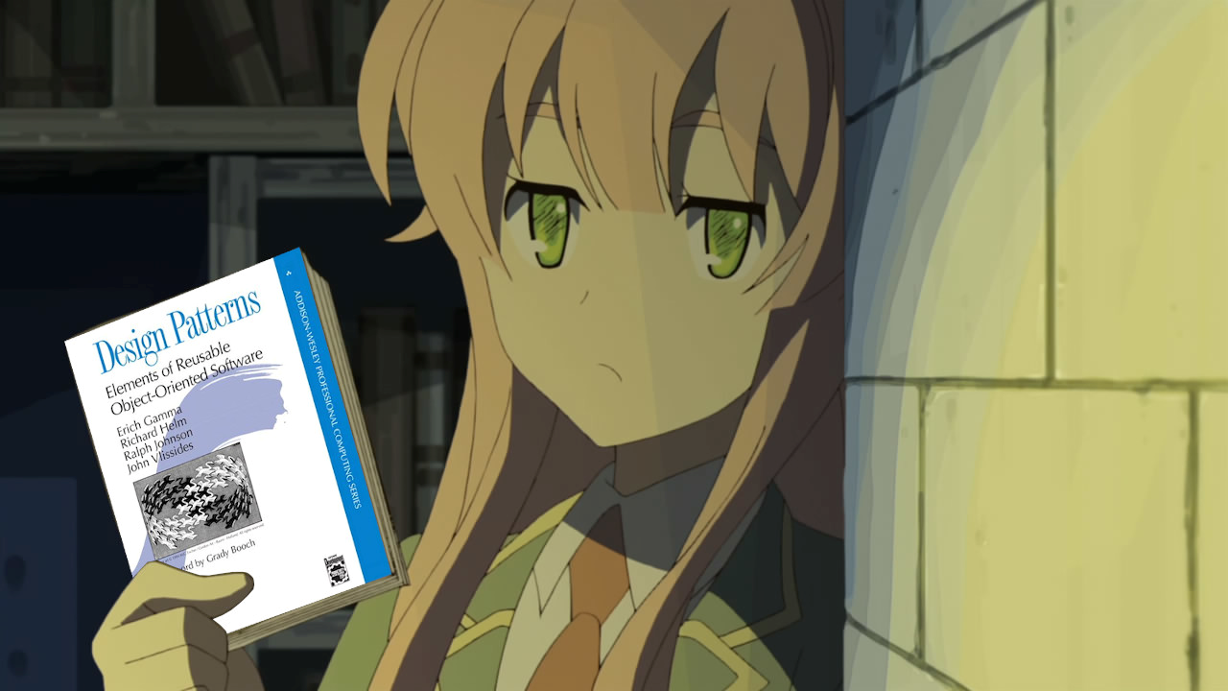
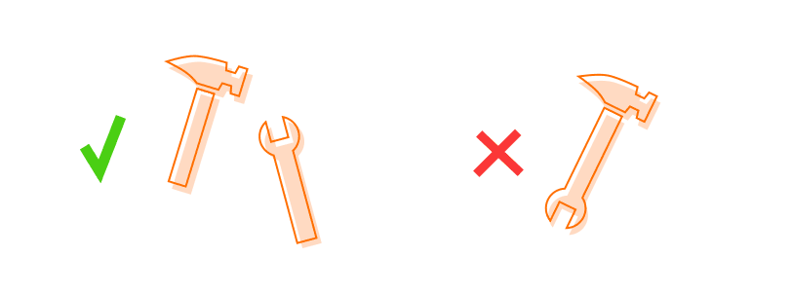
S is for Single Responsibility Principle (SRP)
This principle states that each class should have one responsibility, one single purpose. This means that a class will do only one job, which leads us to conclude it should have only one reason to change

Slide 4

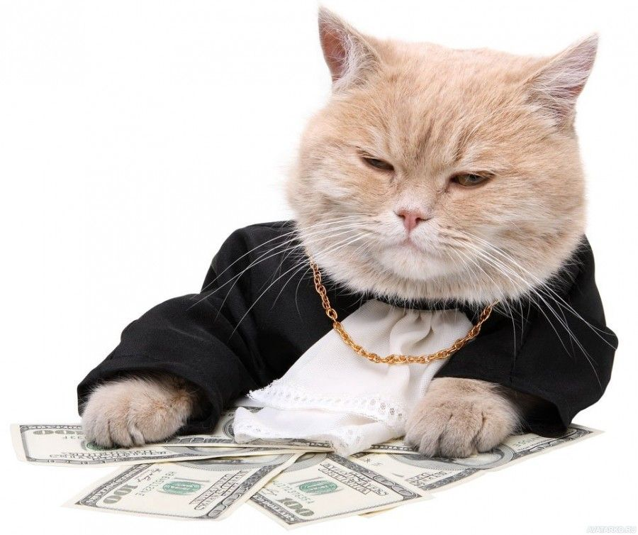
A painted cat
Rich Cat
O is for Open/Closed Principle (OCP)
software entities (classes, modules, functions, etc.) should be open for extension, but closed for modification
Key Concept
The idea is to allow classes to be easily extended to accommodate new functionality without changing existing code.
But they're both cats.

Slide 5






L is for Liskov Substitution Principle (LSP)
"Objects in a program should be replaceable with instances of their subtypes without altering the correctness of that program." — Barbara Liskov
an ambulance and a racing car can drive on the ground, but a helicopter cannot, so the helicopter does not comply with the basic conditions

Slide 6
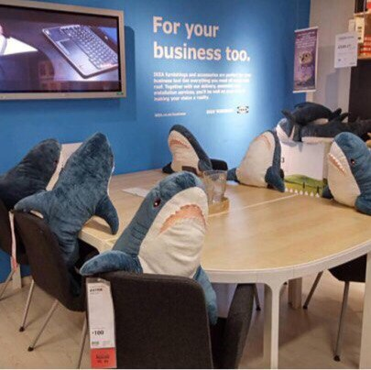
Payment Interface
-> Card
->PayPal
I is for Interface Segregation Principle (ISP)
class should not be forced to implement methods it doesn’t need
Online
-> Card
-> PayPal
Shop
-> Card
In other words, a class should have small, focused interfaces rather than large, monolithic ones.
Payment Interface
Card Interface
PayPal Interface

Slide 7
D is for Dependency Inversion Principle (DIP)
Manager
High-level modules, which provide complex logic, should be easily reusable and unaffected by changes in low-level modules, which provide utility features.
Office Manager
Work Manager

Slide 8
THANK YOU
Artem Otliaguzov​

